Slide 1
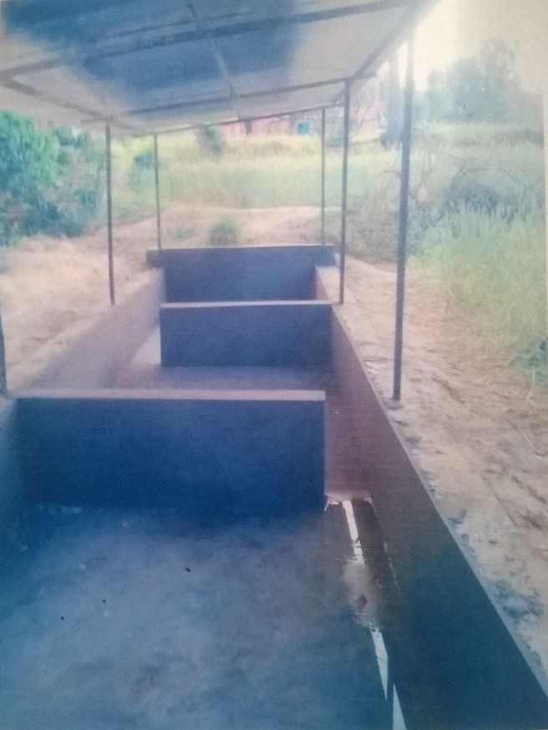
SOM DUTT S/O JAGDISH RAJ R/O BHABBER, REASI
VERMICOMPOST UNIT UNDER SCHEME PMDP 2016-17

Slide 2
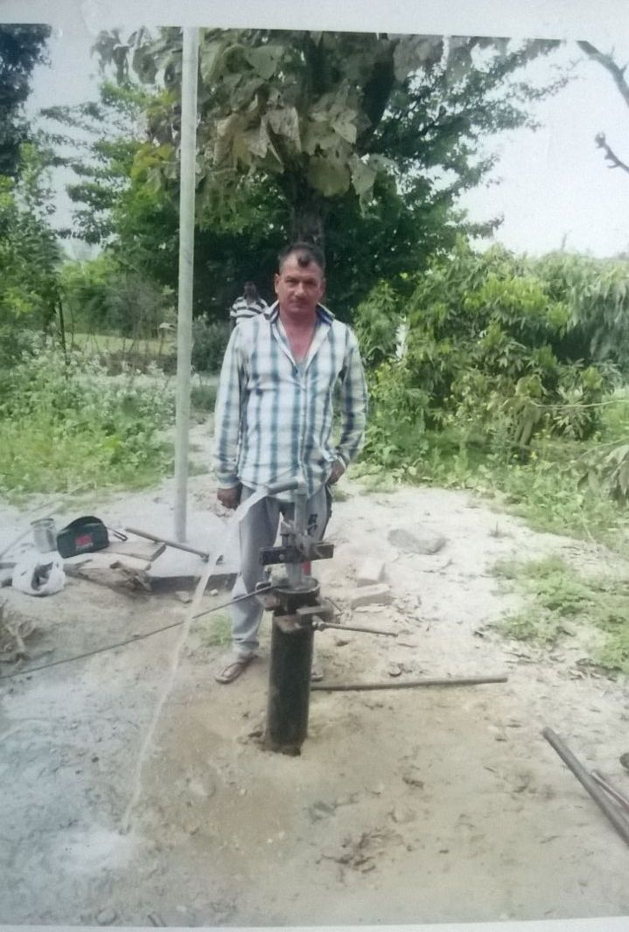
OM PARKESH S/O BINDRO R/O BHABBER, REASI
BOTH BORE WELL WITH WATER STORAGE TANK UNDER SCHEME PMDP 2016-17

Slide 3
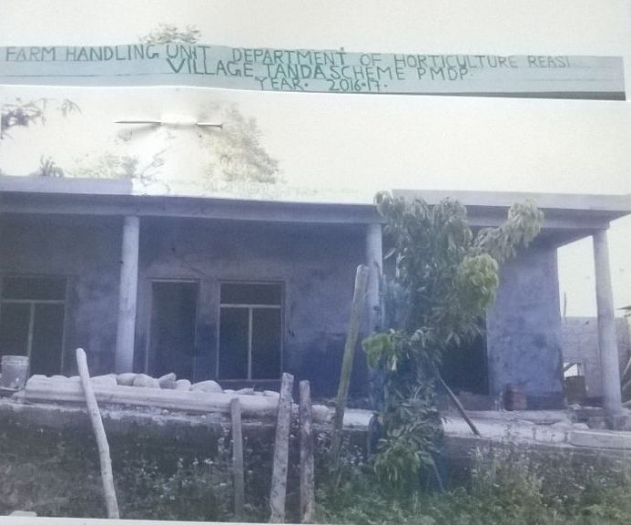
Sardar Sucha Singh R/o Tanda, Reasi
On Farm Handling Unit Under Scheme PMDP 2016-17

Slide 4
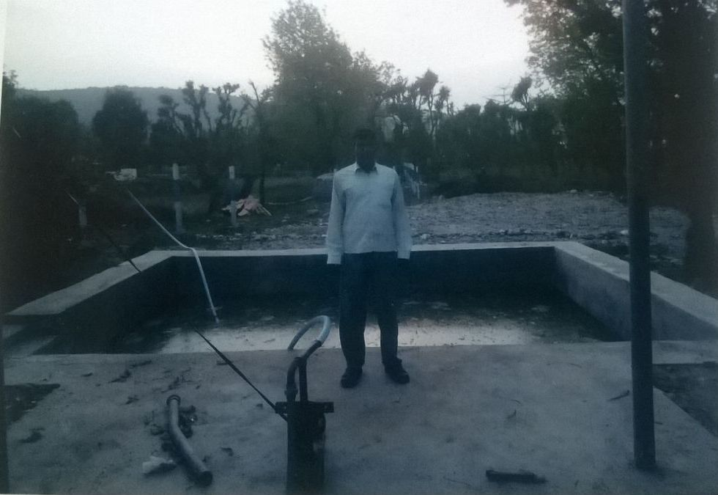
Mohd Rouf S/o Mohd Shrief R/o Mansoo, Reasi
Both Bore with Water Storage Tank Under Scheme PMDP 2016-17

Slide 5
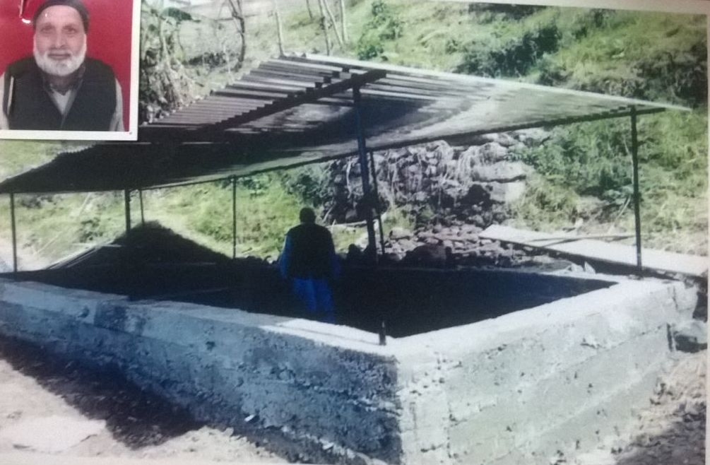
Shah Wali S/o Lal Din R/o Thuroo
Vermicompost Unit under Scheme PMDP 2016-17 Block Arnas, Reasi

Slide 6
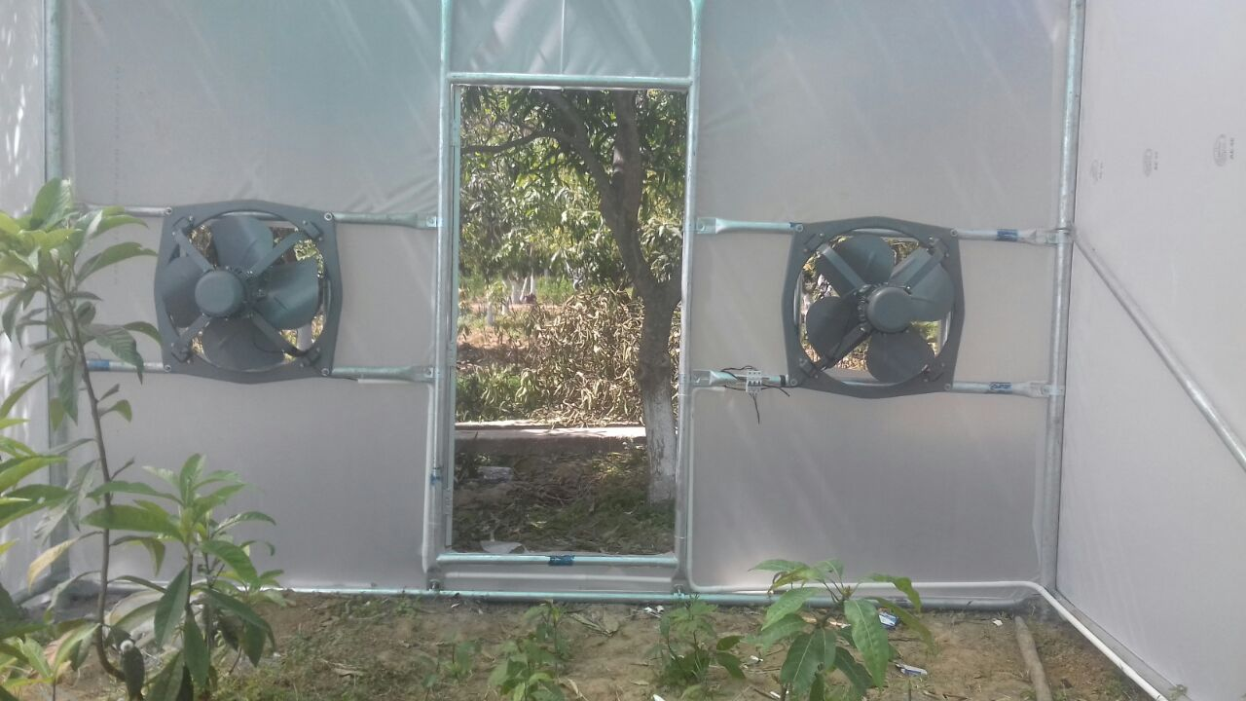
INSTALLATION OF POLY GREEN HOUSE WITH FAN & PAD SYSTEM AT POUNI NURSERY

Slide 7
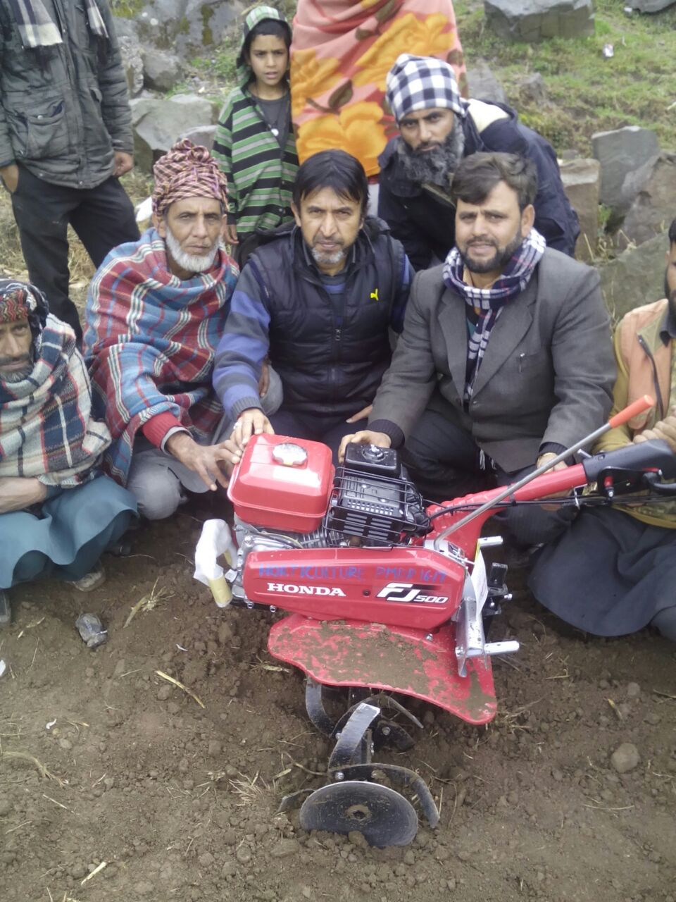
MOHIU DIN MALIK R/O BATHOIE, MAHORE
POWER TILLER UNDER SCHEME MIDH 2016-17

Slide 8
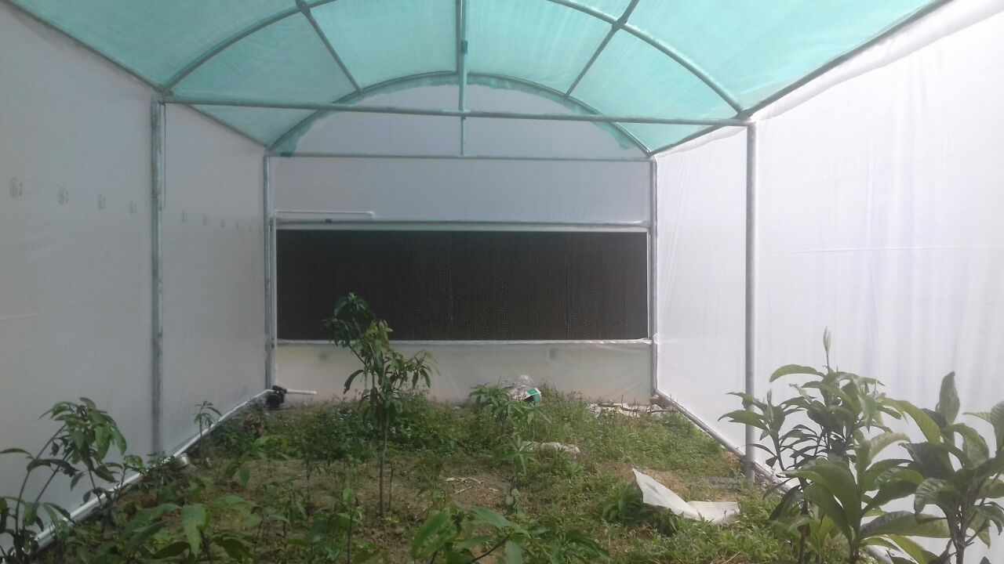

Slide 9
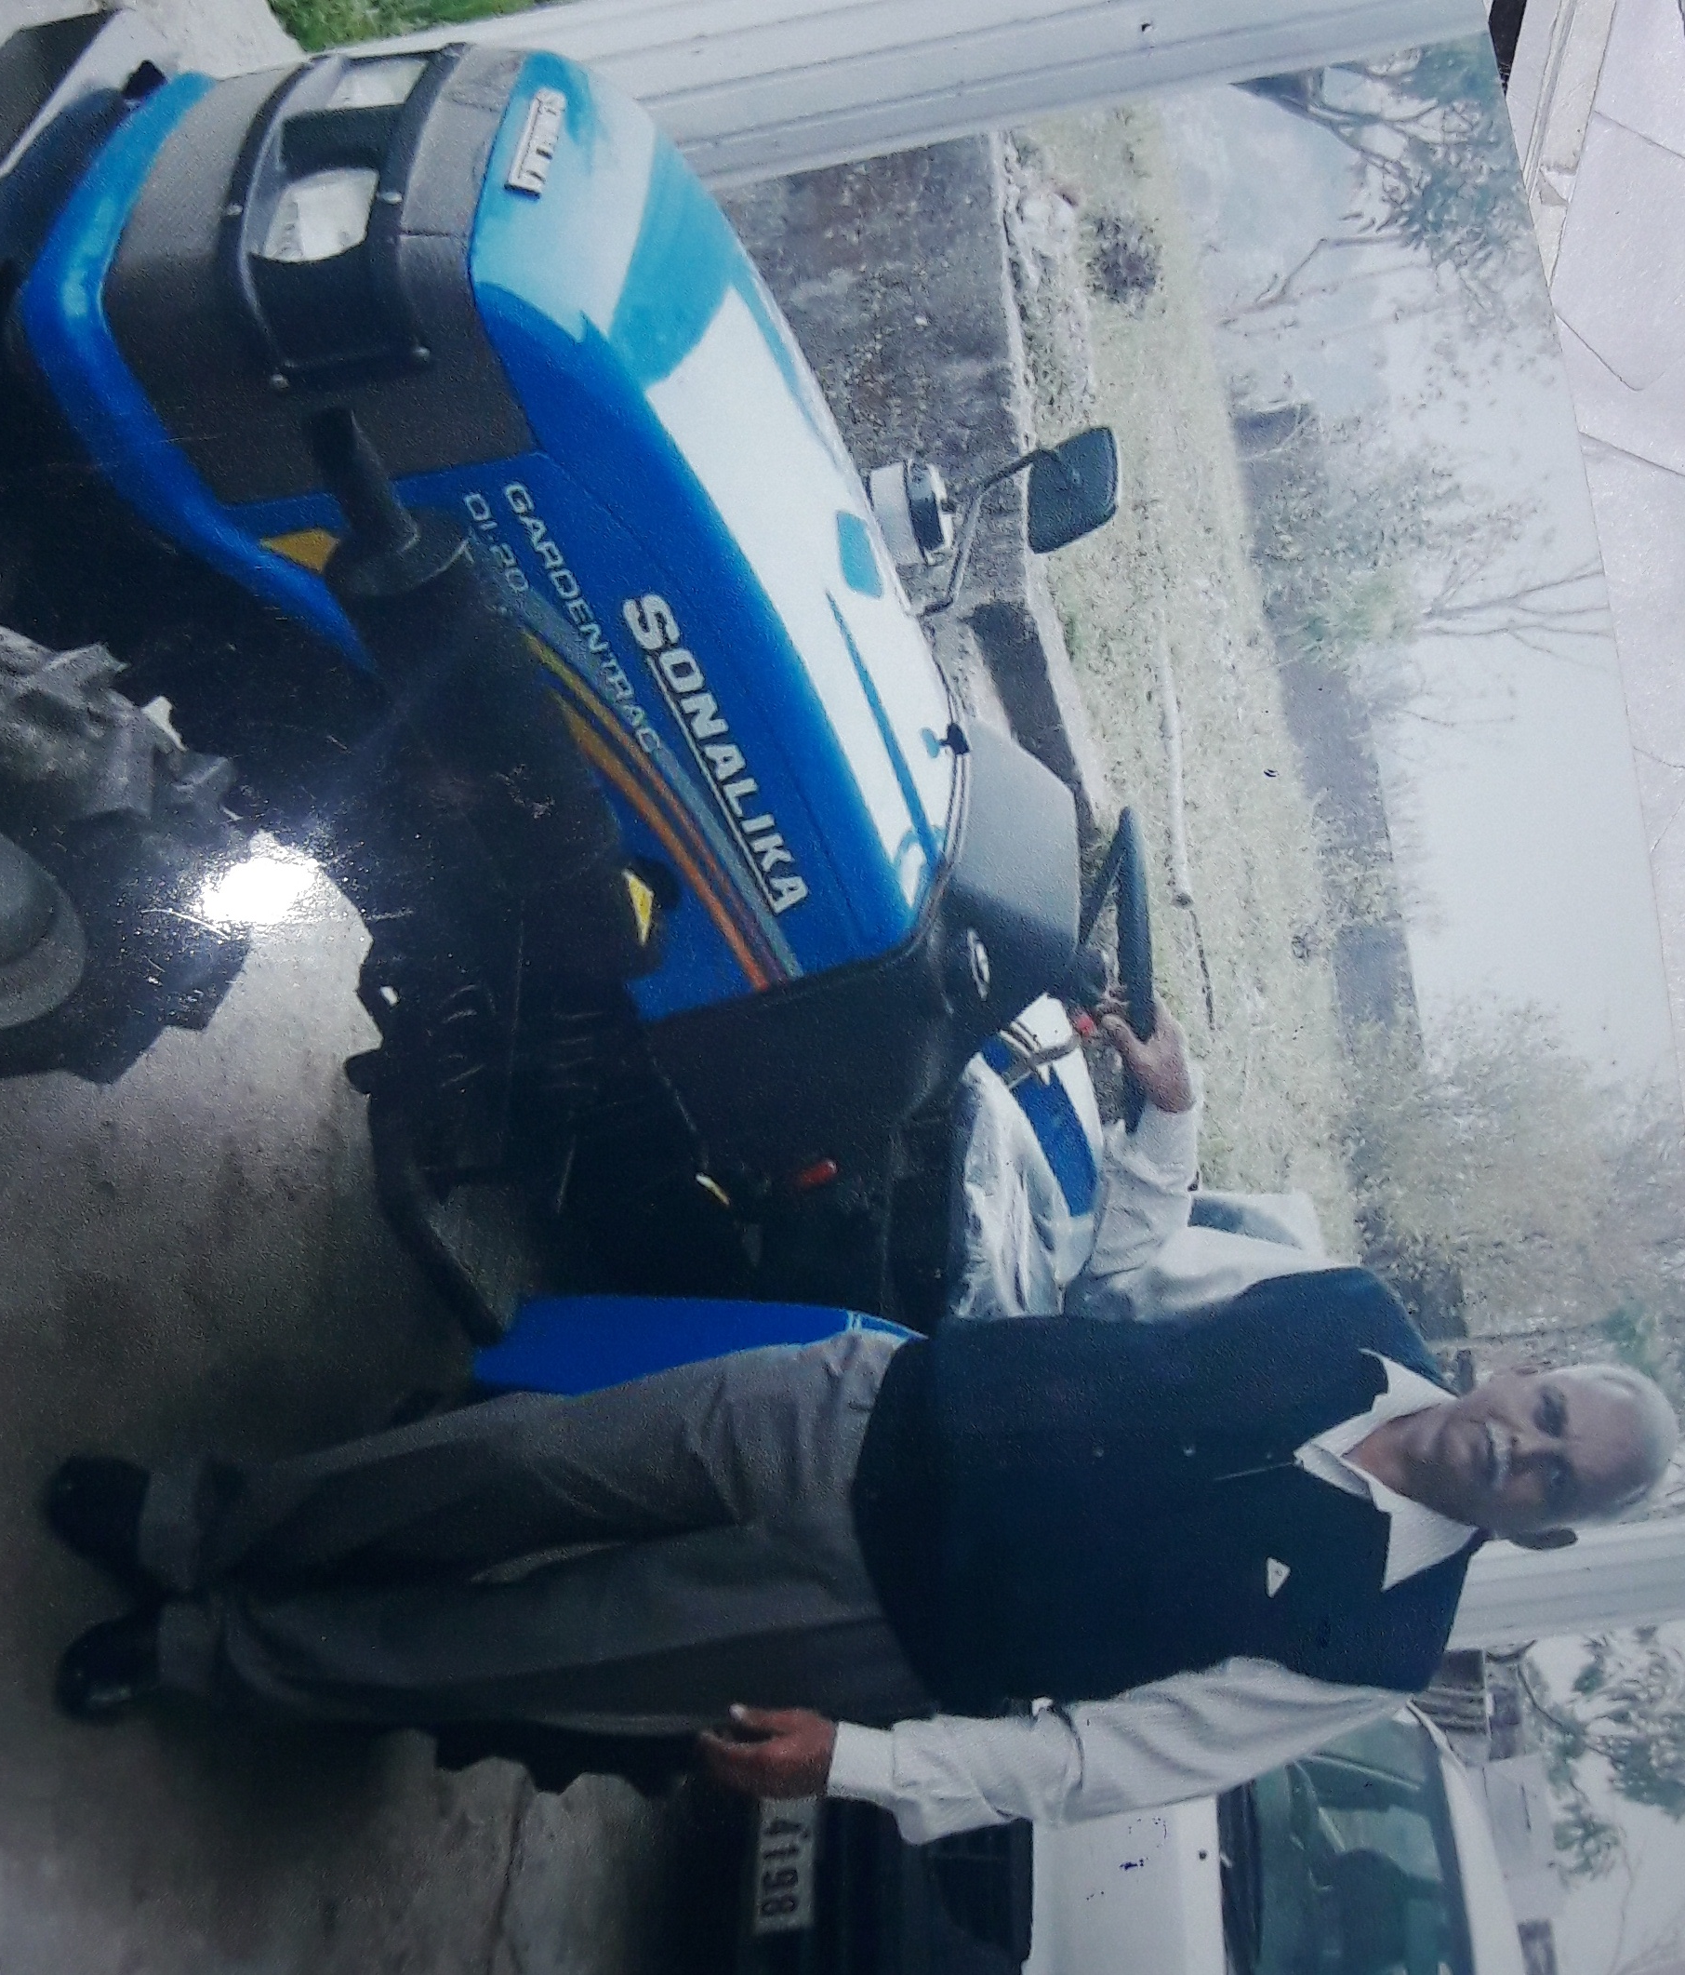
SURINDER SINGH R/O BHAGA TRACTOR UPTO 20 BHP UNDER PMDP 2016-17

Slide 10
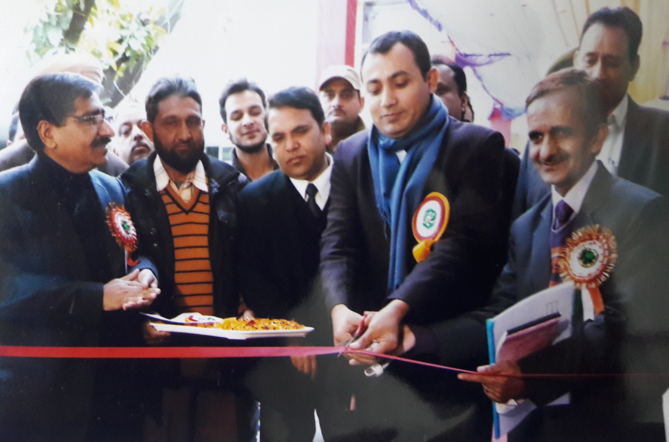
DISTRICT LEVEL FRUIT SHOW 2016-17

Slide 11
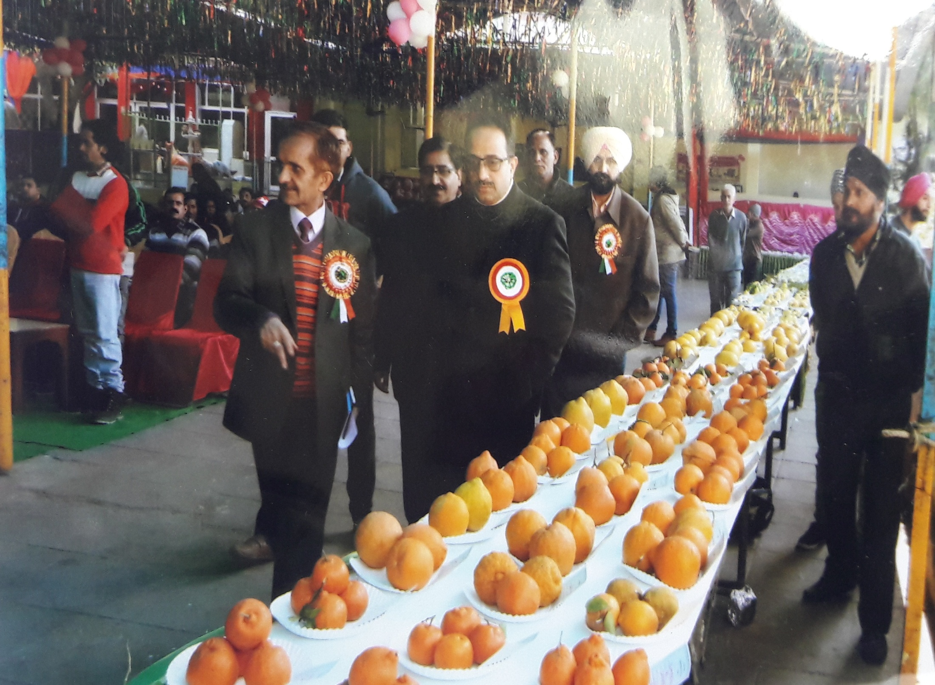

Slide 12
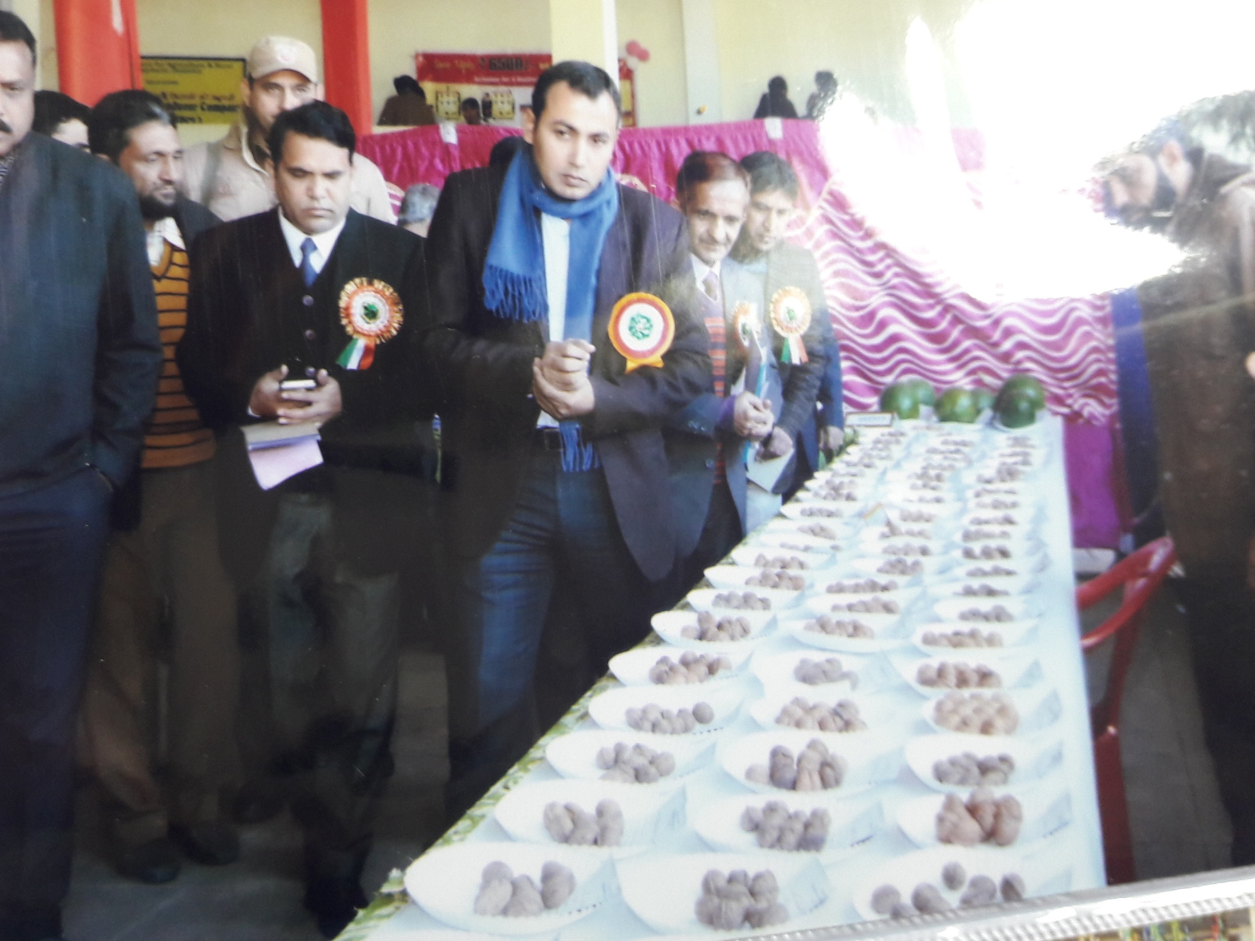

Slide 13
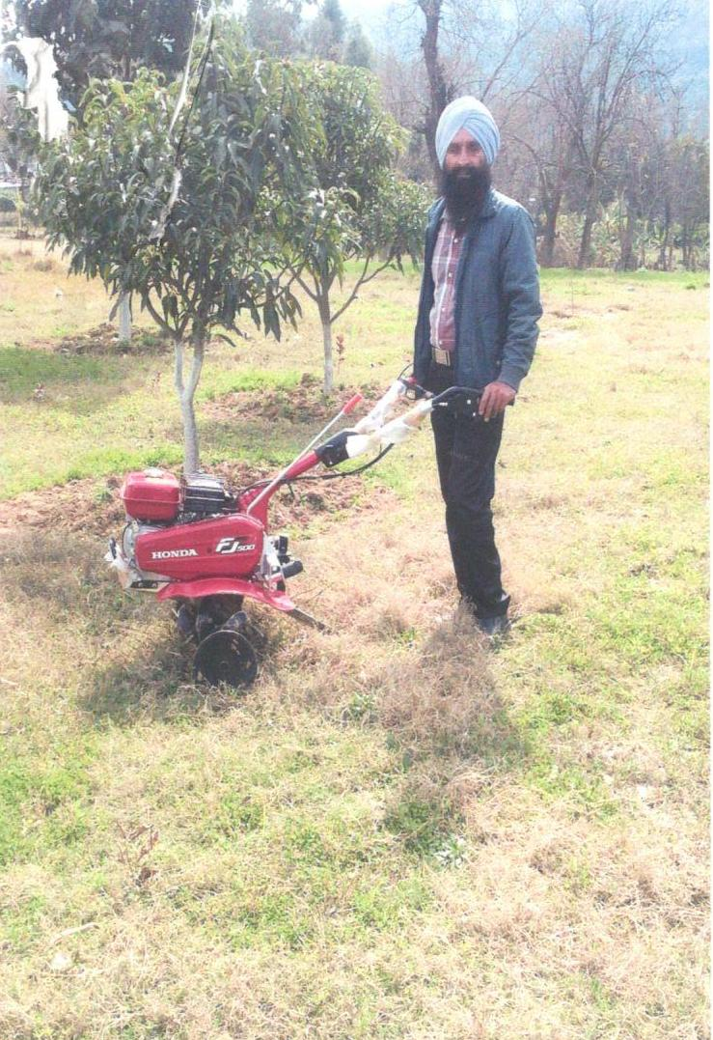
Gurdev Singh Under Scheme SMAM

Slide 14
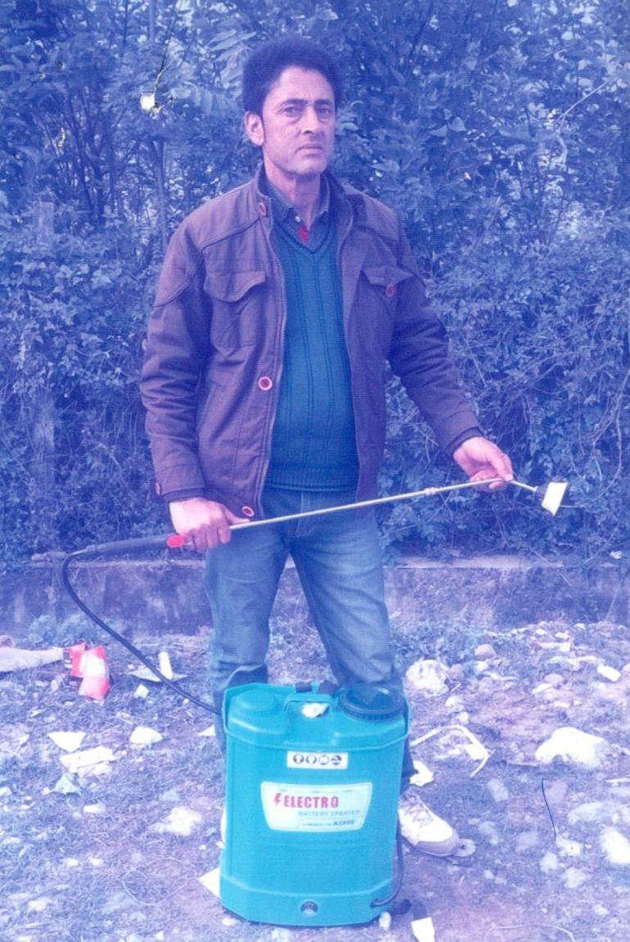
Bharat Singh Under Scheme RKVY

Slide 15
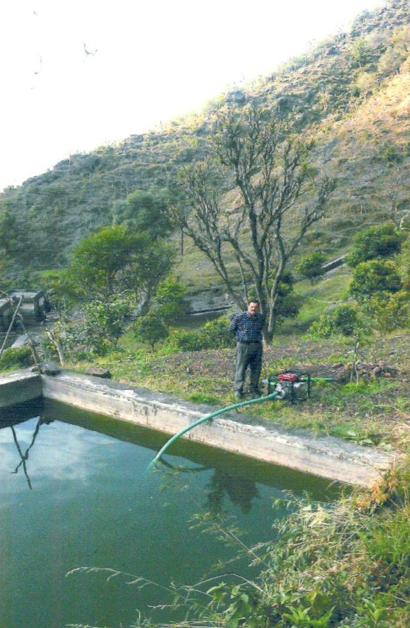
Son Singh Under Scheme RKVY

Slide 16
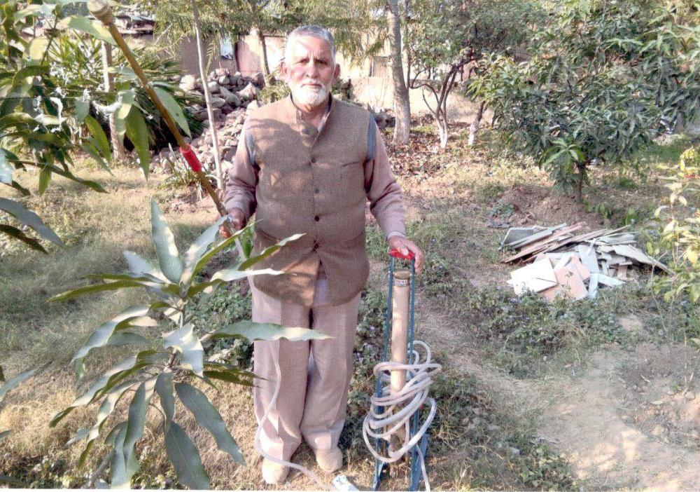
Gulam Ali Malik under Scheme RKVY

Slide 17
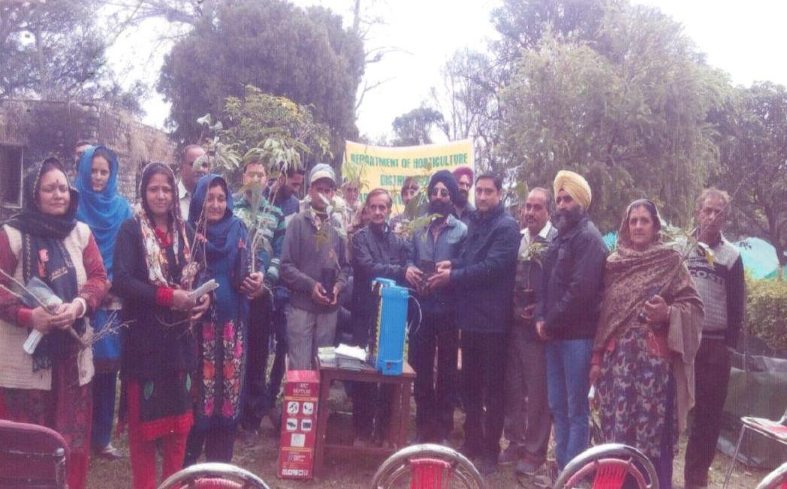
Awareness Camp at Pouni Block

Slide 18
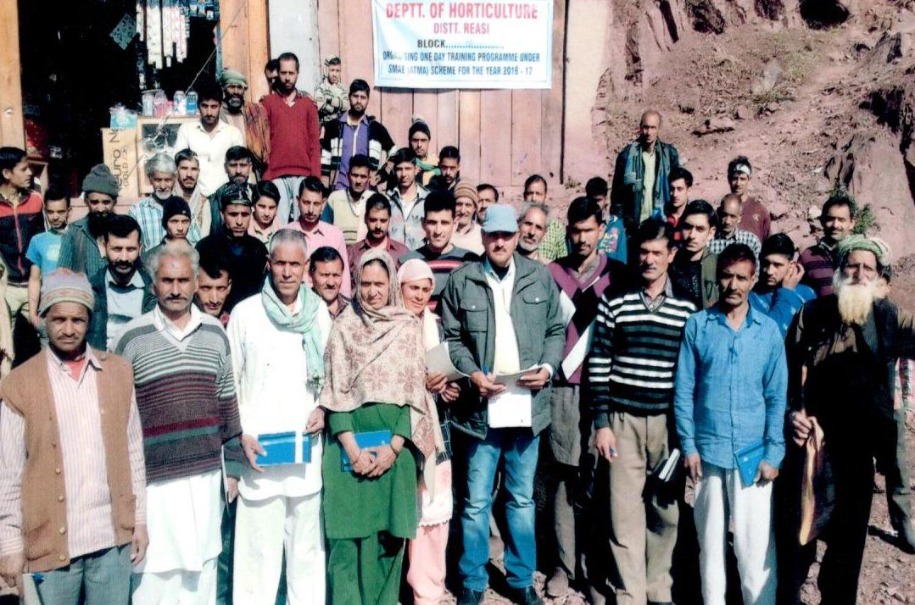
Awareness Camp at Arnas Block

Slide 19
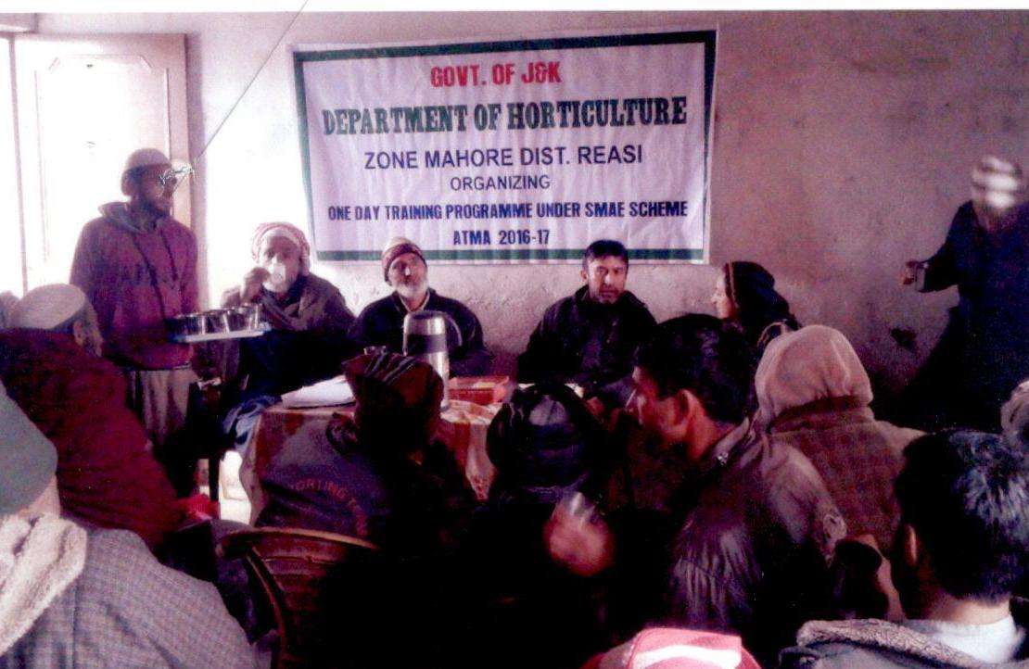
Awareness Camp at Mahore Block

Slide 20
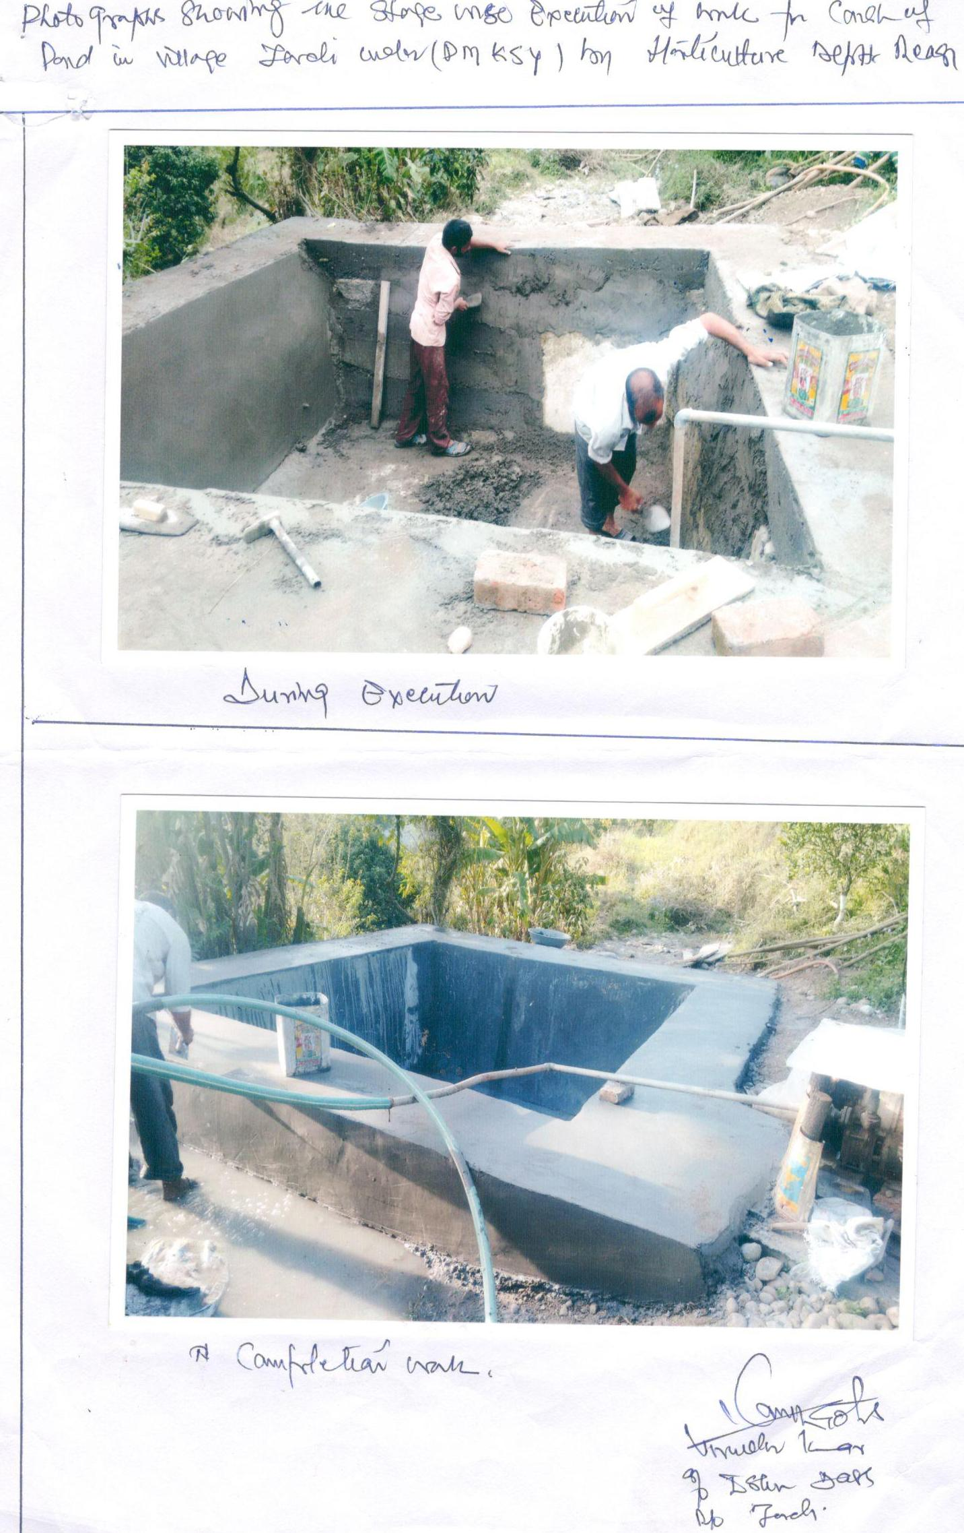
Varinder Kumar Under Scheme PMKSY

Slide 21
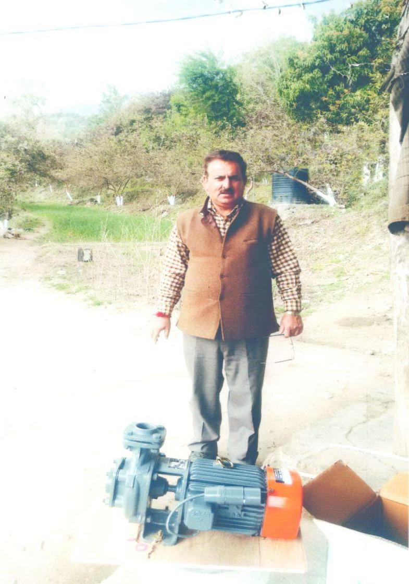
Varinder Kumar Under Scheme PMKSY

Slide 22
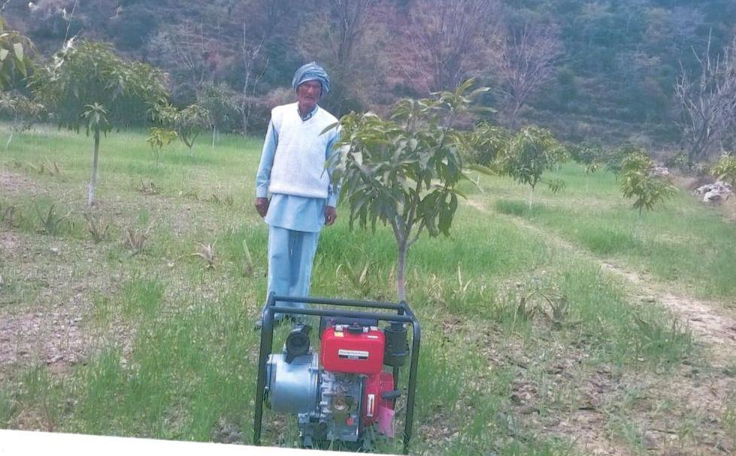
Kartar Nath Under Scheme PMKSY

Slide 23
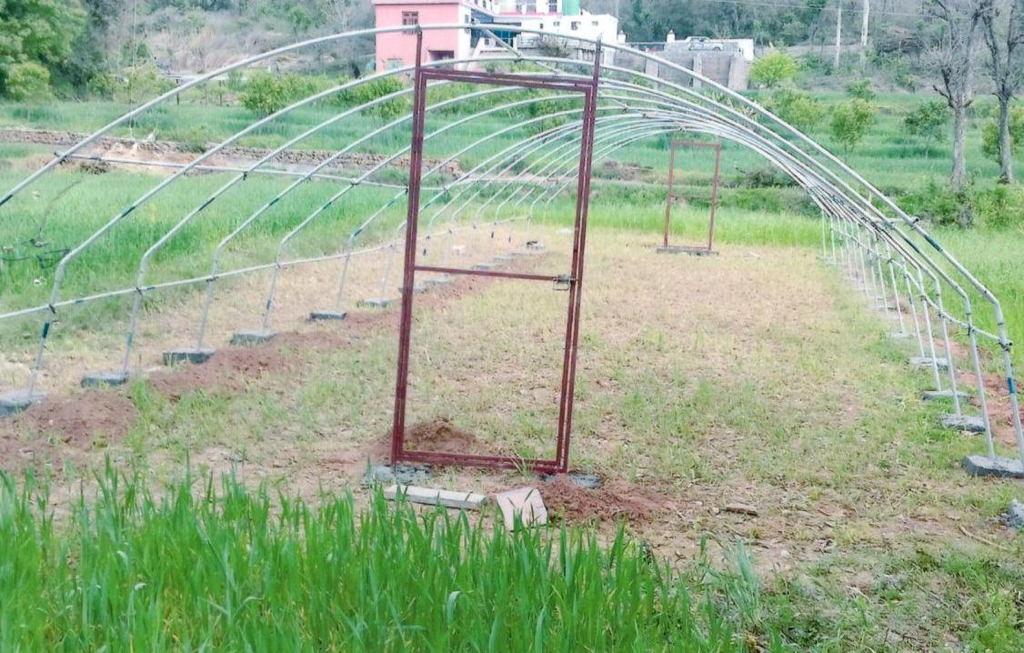
Des Raj Under Scheme MIDH

Slide 24
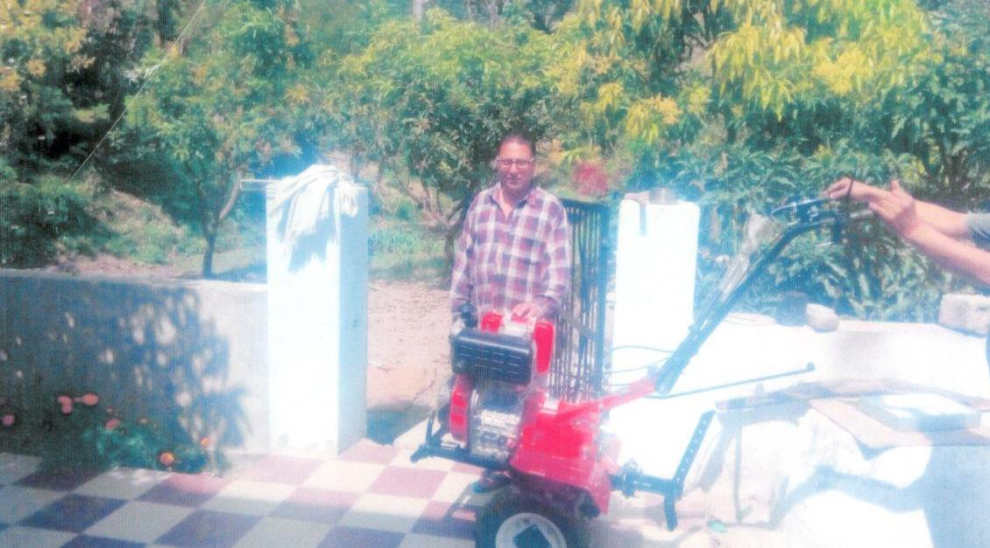
Madan Lal Under Scheme MIDH

Slide 25
THANKS

