Slide 1
Major Achievements for the year 2016-17 with respect to Advanced Centre For Horticulture Development Ramban Under various Schemes

Slide 2
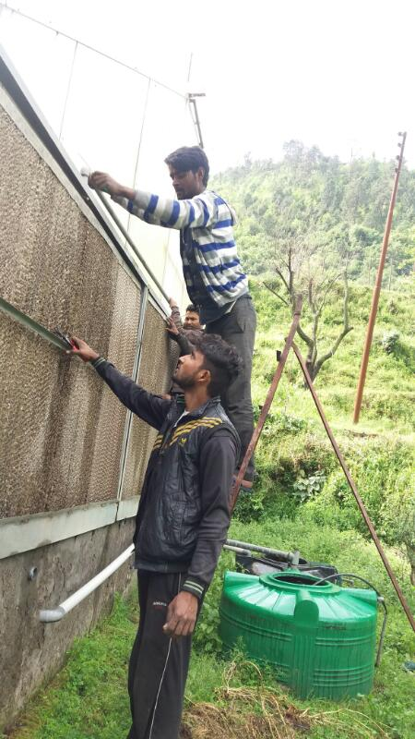
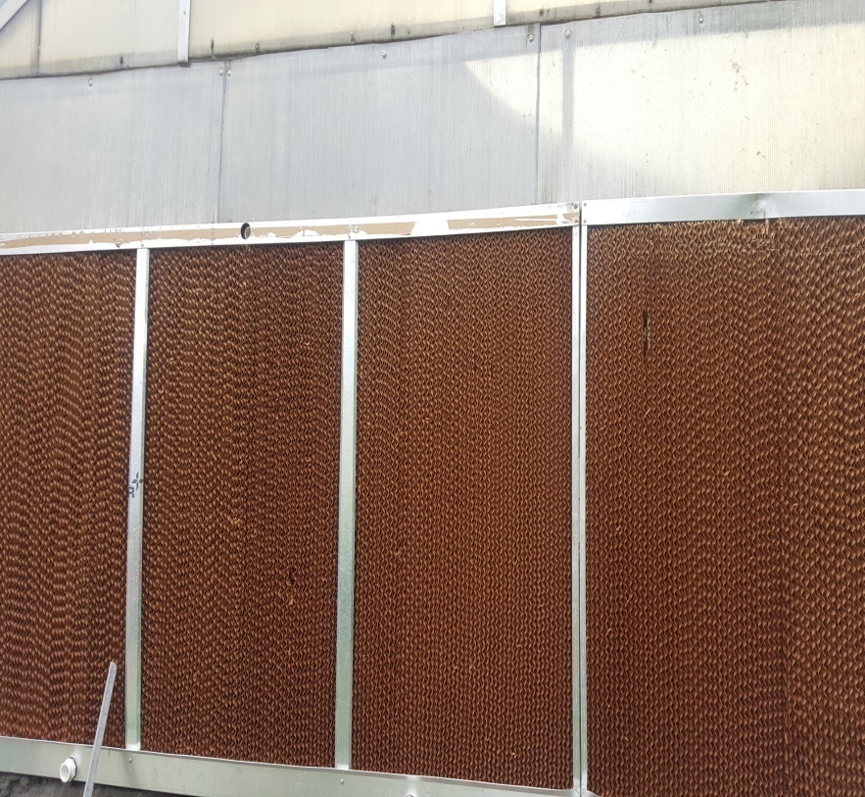
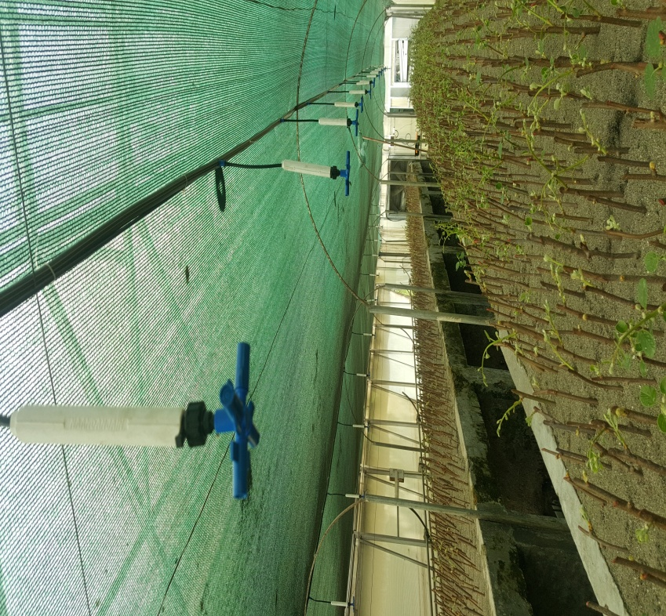
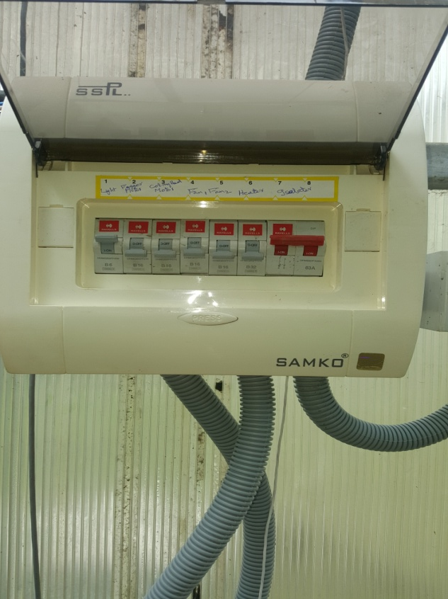
Repair and Reinstallation of 04 Nos High tech Green Houses

Slide 3
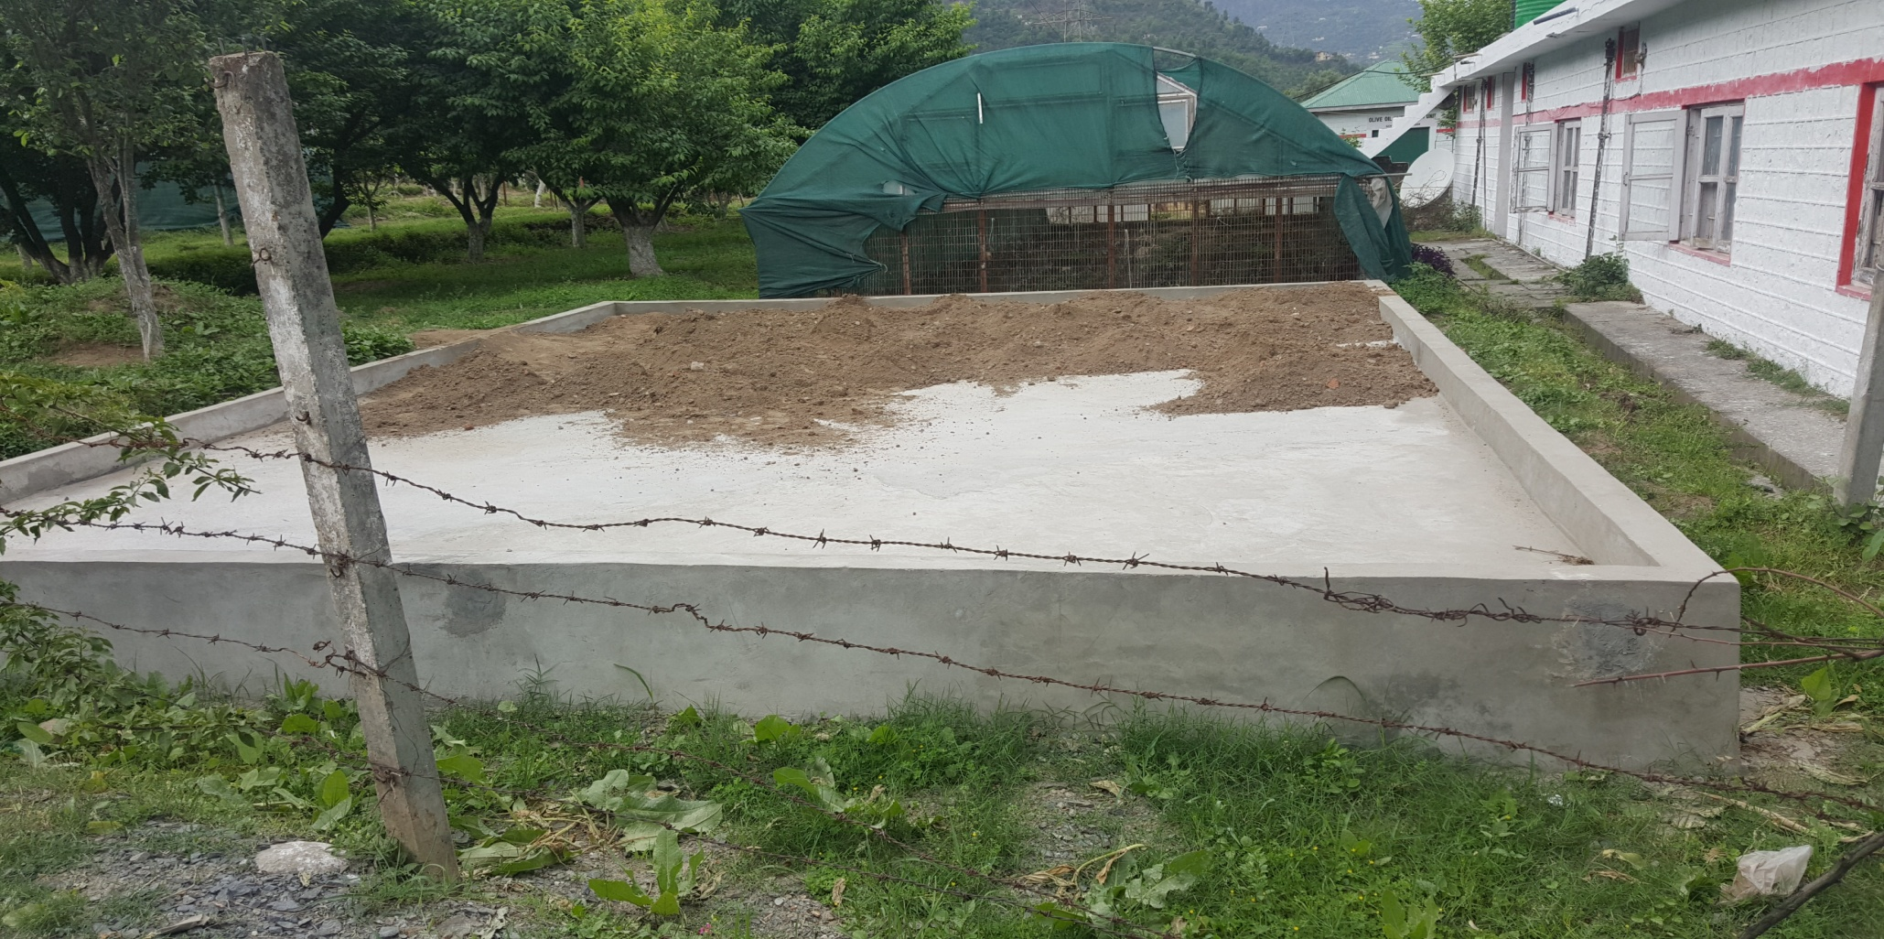
Newly Constructed Soil Solarization Platform for solarisation and there by sterilizing the soil by solar light

Slide 4
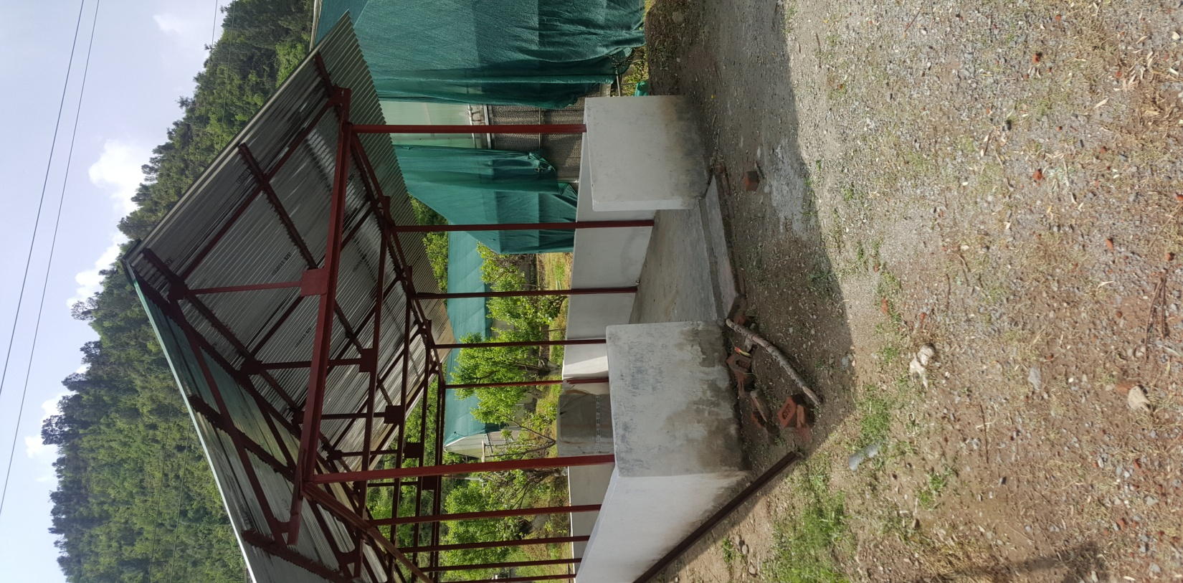
Newly Constructed Working Shed for performing various nursery Operations like budding/Grafting, Polybag filling, Seed extraction etc. during normal as well as odd weather conditions

Slide 5
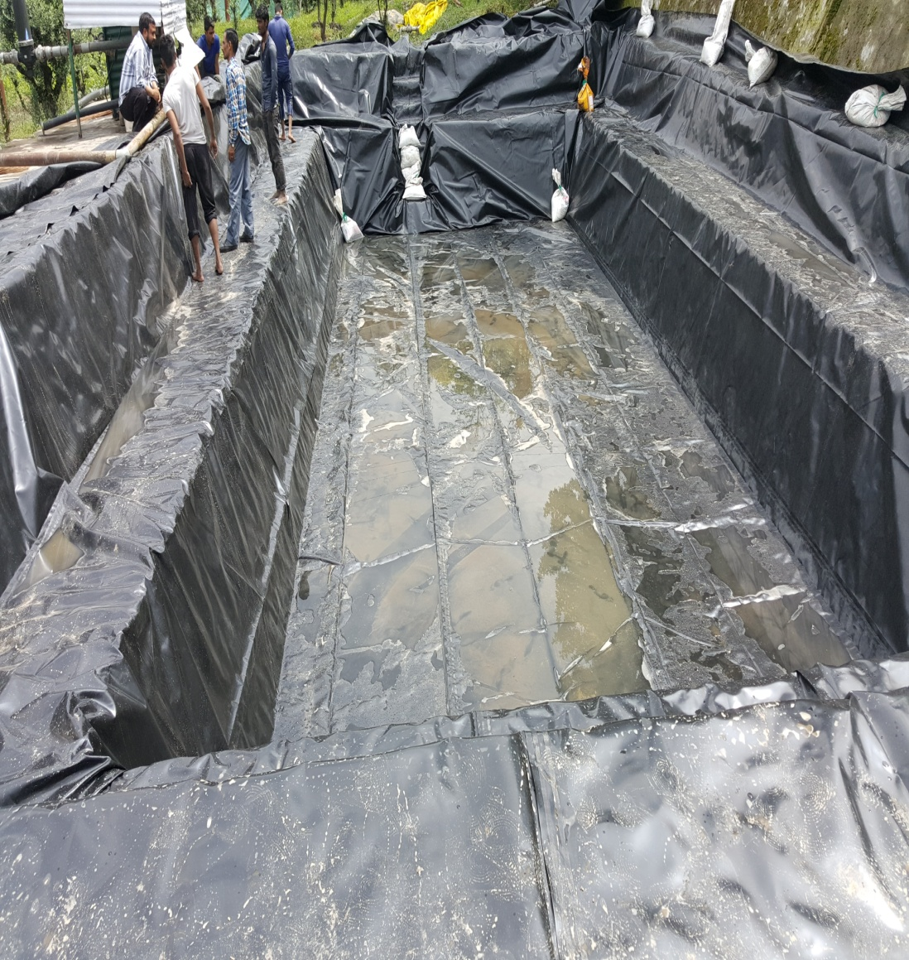
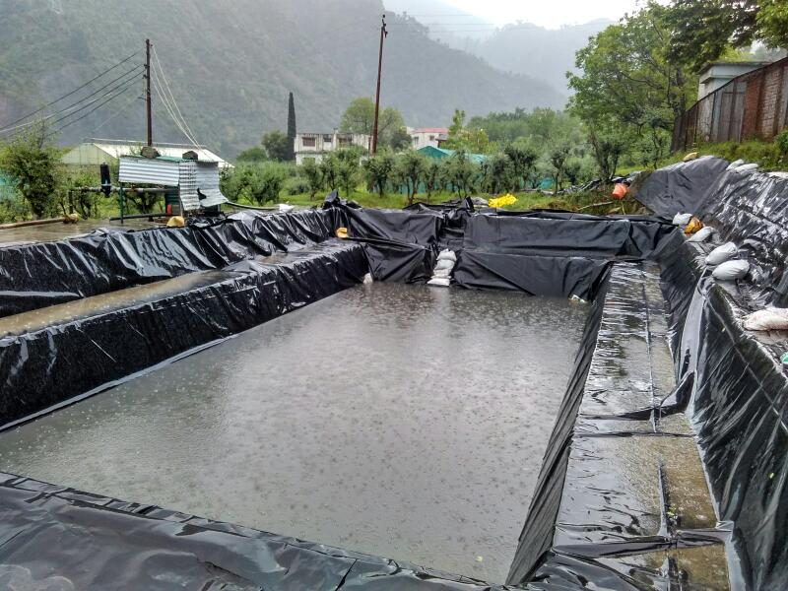
Polylining of Damaged water tank with HDPE Polylining

Slide 6
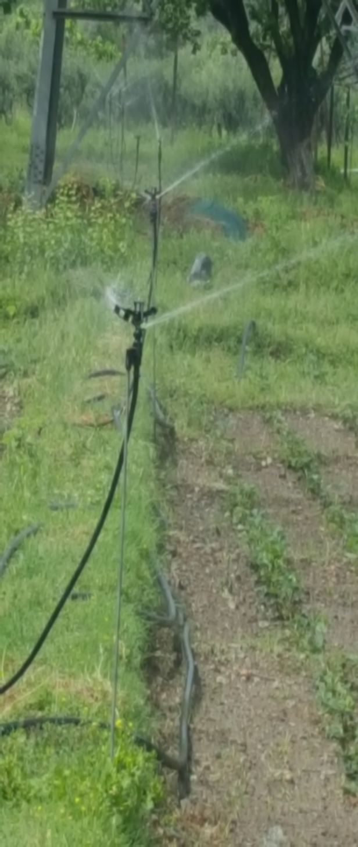
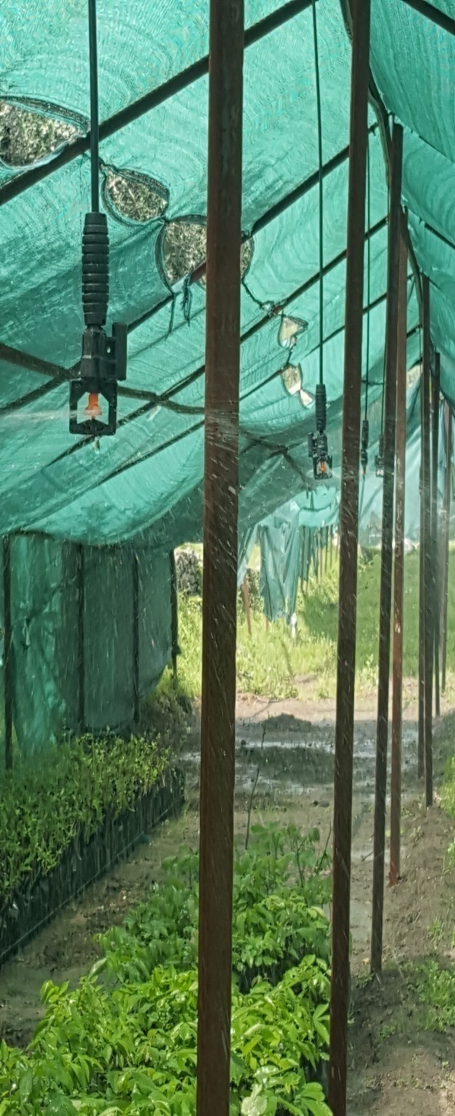
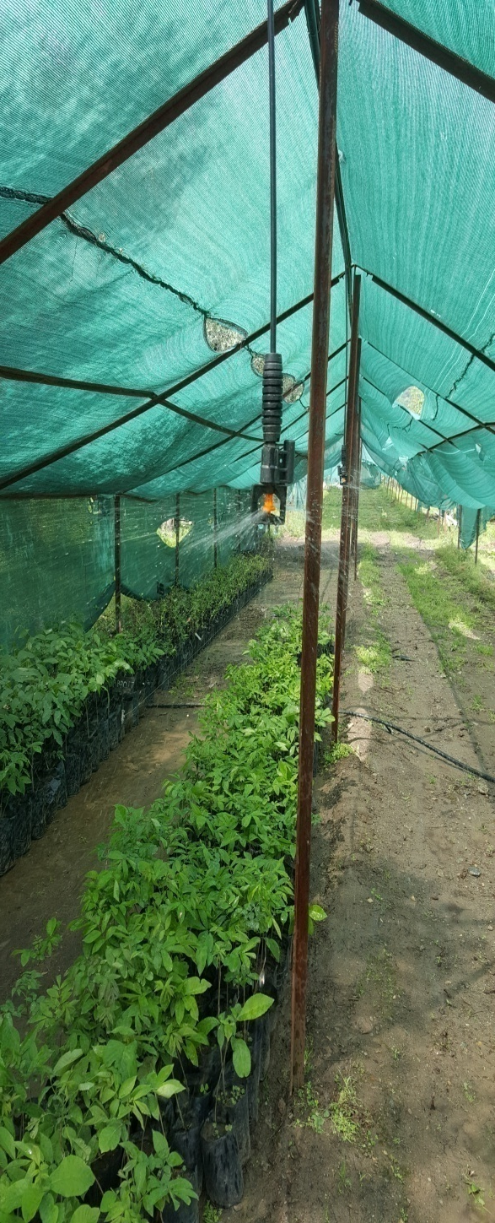
Micro irrigation through installation of Sprinkler System, Mister lines installation covering an Area of about 3.0 hectares which will result in decreased water utilization and optimum moisture levels required.

Slide 7
